Slide 1
PRAYER DOME REVIVAL GLOBAL · PUBLICATIONS
NEWLY LAUNCHED · SEVEN TITLES
The Books.
A presentation of the titles authored by Apostle Praise A. P. Oluwafemi — each one a teaching instrument for faith, freedom and kingdom increase.
1 / 30

Slide 2

BOOK 01
01
The Covenant of Wealth Multiplication
Unlocking God's Principles for Supernatural Supplies & Multiples
“In blessing I will bless thee, and in multiplying I will multiply thee.” — Genesis 22:17
2 / 30

Slide 3
BOOK 01 · THE COVENANT OF WEALTH MULTIPLICATION
Inside this book, you will discover
Why God is the source, supplier and multiplier of every need
How the Abrahamic Covenant still governs the blessing of believers today
Why God moves upon the hearts of people to become channels of your harvest
How famine and grinding breakdowns can become the greatest covenant blessings
Why rain and drought seasons can become the greatest opportunities for supernatural increase
What God meant when He promised to multiply Abraham's seed like the stars of heaven and the sand on the seashore
3 / 30

Slide 4
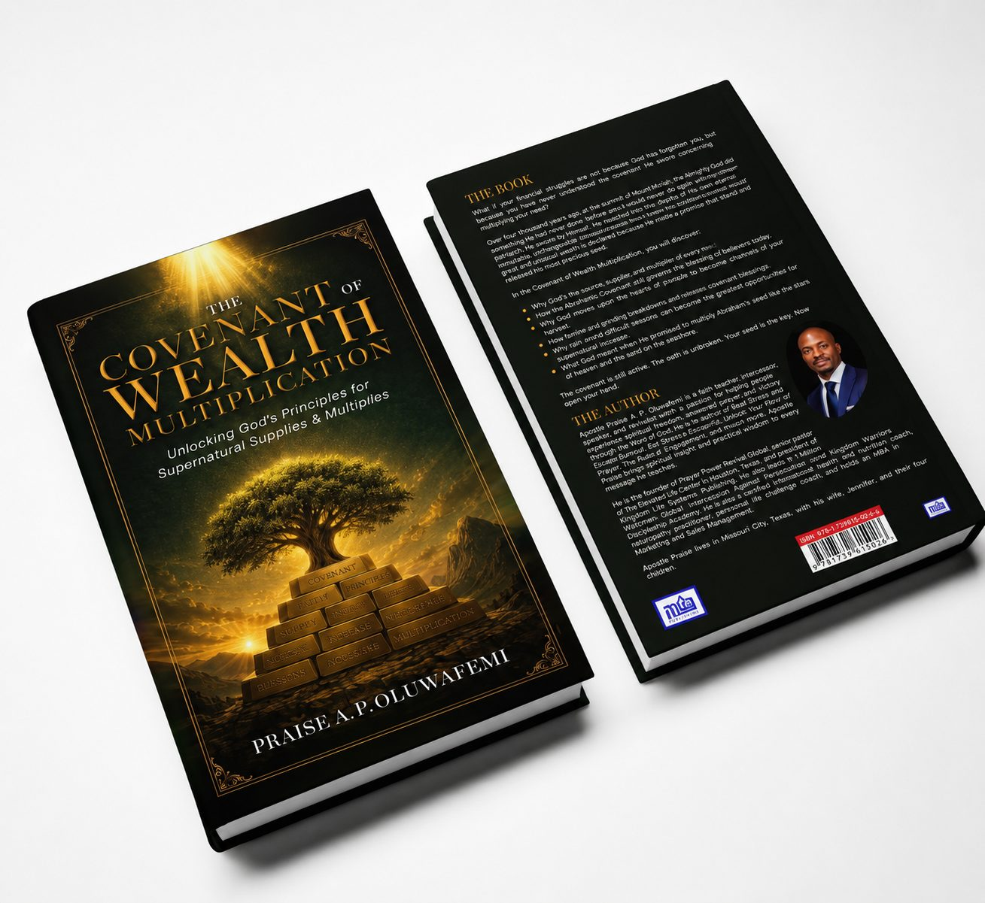
BOOK 01 · GALLERY 1/2
What if your financial struggles are not because God has forgotten you, but because you have never understood the covenant He swore concerning multiplying your seed? Over four thousand years ago, at the summit of Mount Moriah, the Almighty God did something He had never done before — He swore by Himself. This book reopens that eternal, unchangeable oath and places the reader inside a covenant of supply, increase and multiplication that is still active today.
HARDCOVER · PRESENTATION EDITION
FRONT & BACK COVER
4 / 30

Slide 5
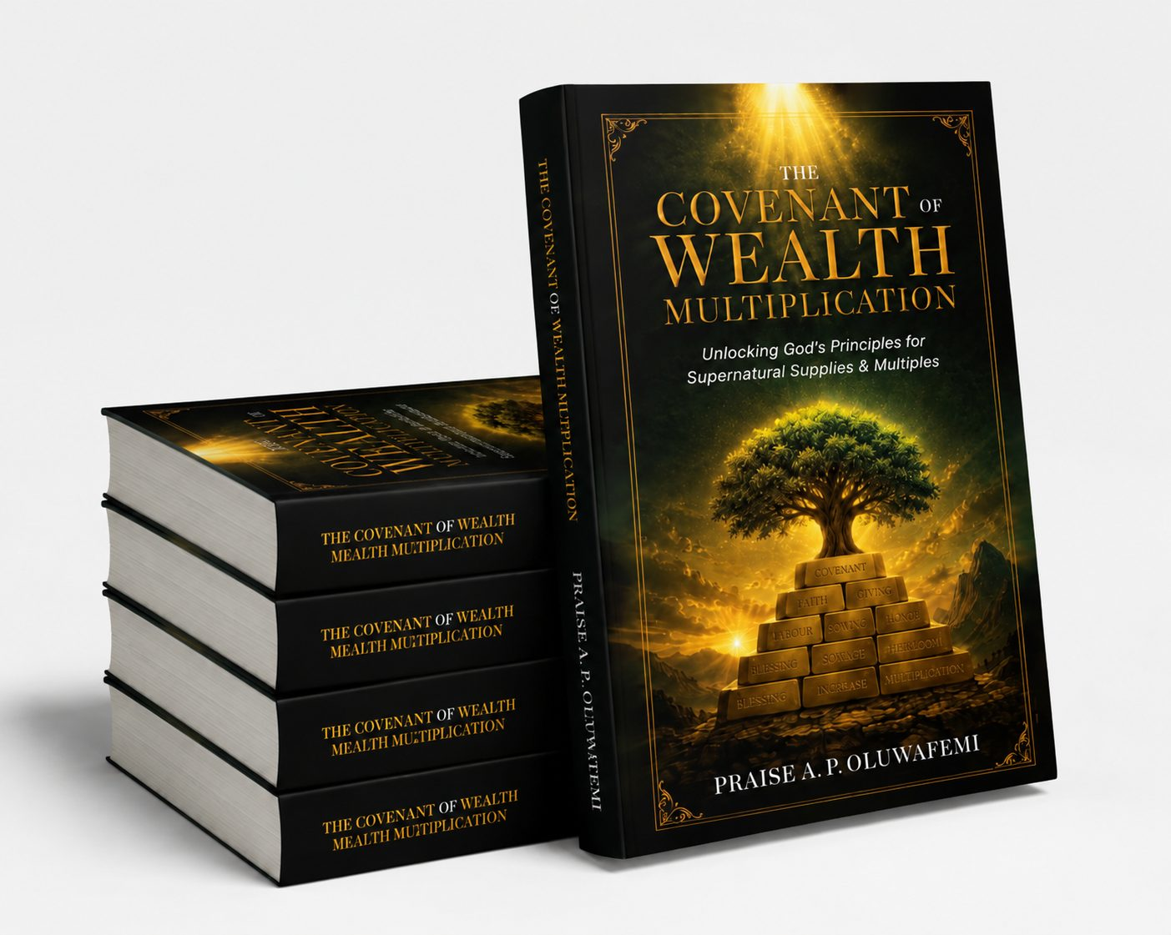
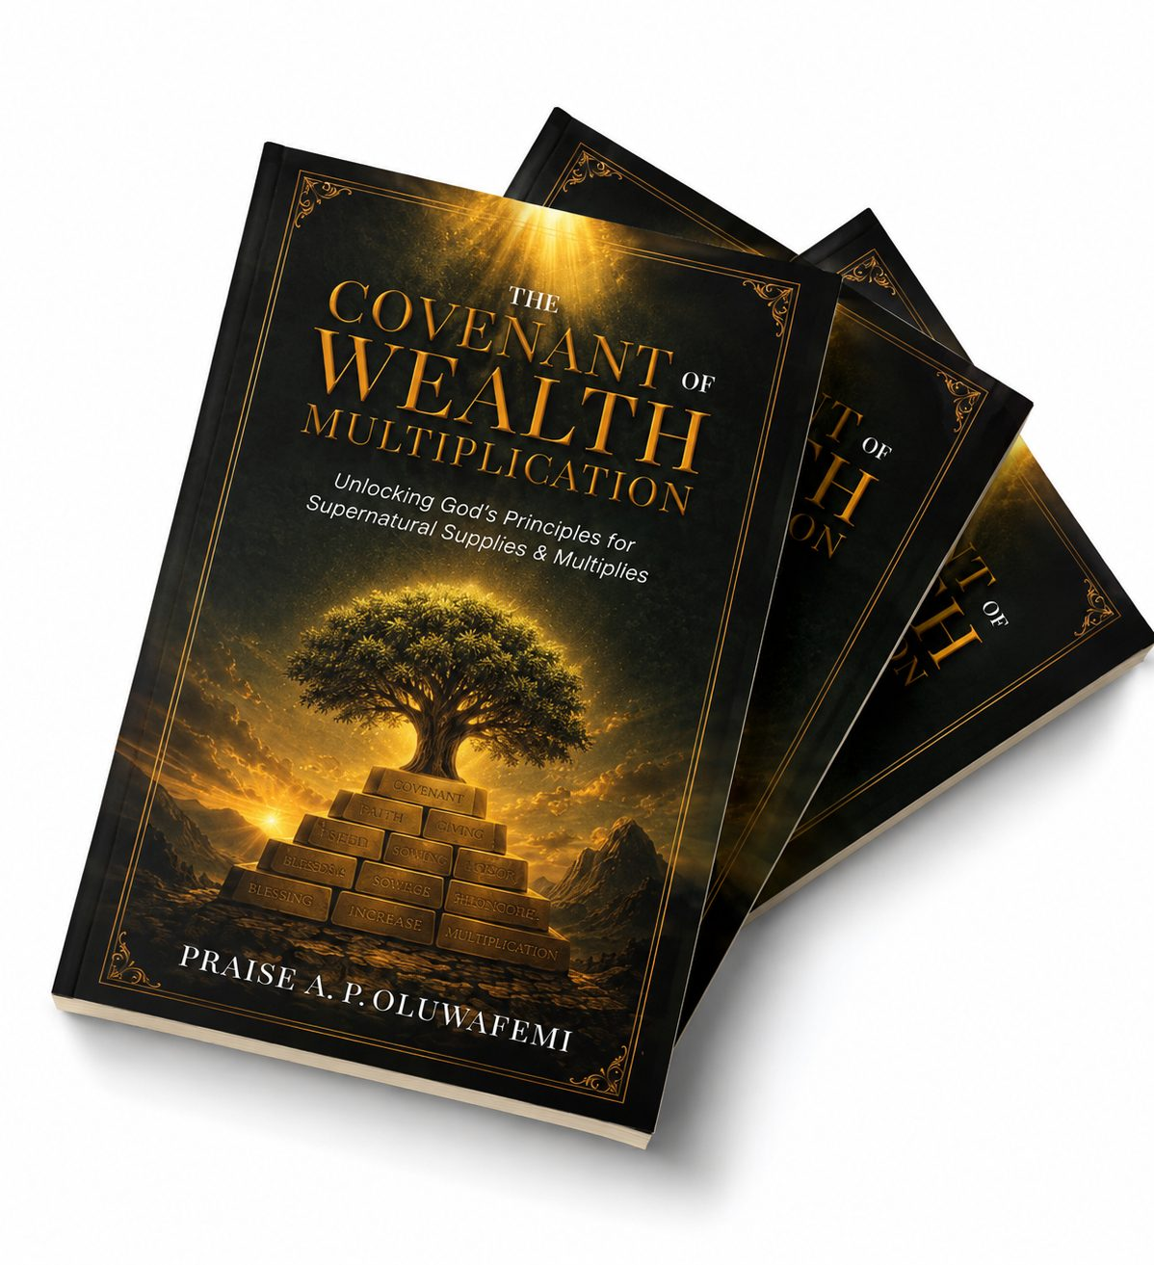
BOOK 01 · GALLERY 2/2
SPINE & STACKED SET
PAPERBACK FAN DISPLAY
5 / 30

Slide 6
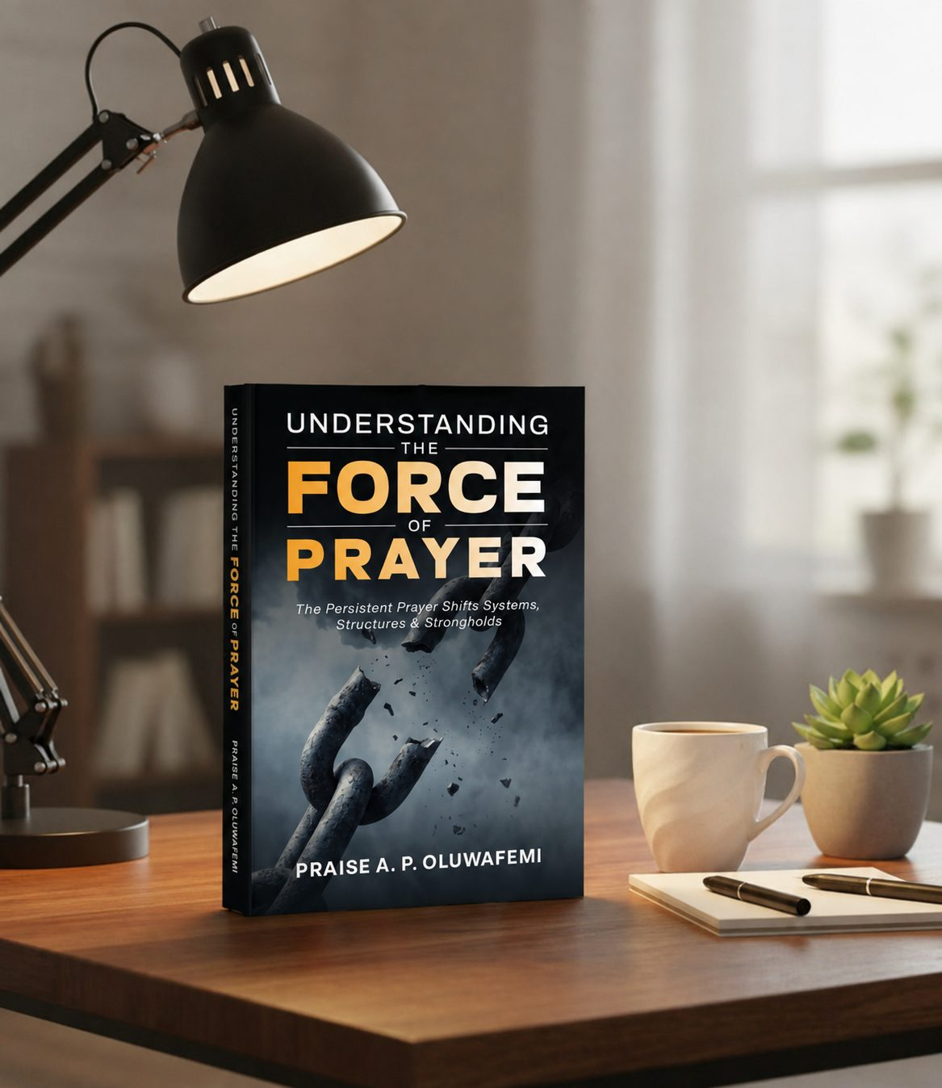
BOOK 02
02
Understanding the Force of Prayer
The Persistent Prayer Shifts Systems, Structures & Strongholds
“Through the greatness of Your power Your enemies shall submit themselves to You.” — Psalm 66:3
6 / 30

Slide 7
BOOK 02 · UNDERSTANDING THE FORCE OF PRAYER
Inside this book, you will discover
The difference between passive praying and prayer that carries force
How persistent prayer dismantles systems, structures and strongholds
Lessons from Elijah, Daniel, Elisha and the importunate widow
Why invisible forces resist believers — and how they are made to submit
How to pray until heaven responds and territories shift
Building a life of importunity that refuses to be denied
7 / 30

Slide 8
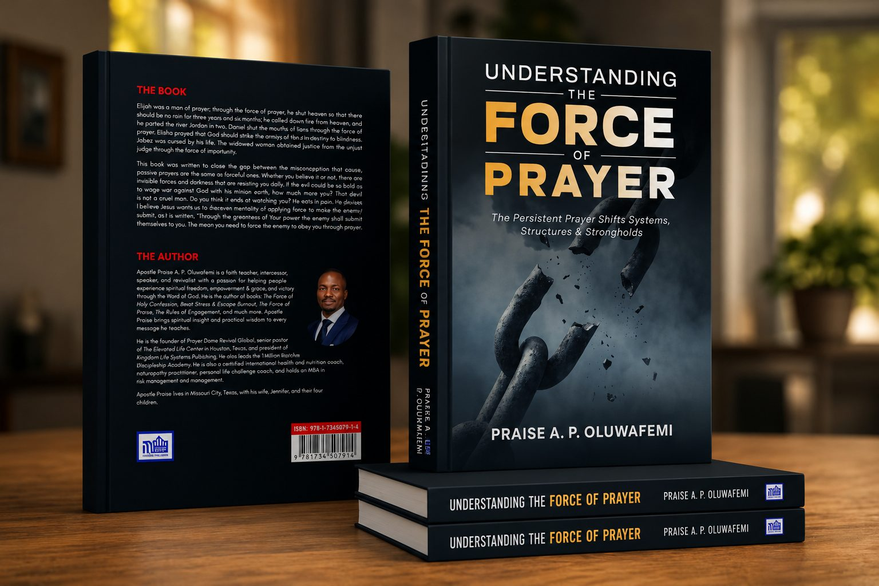
BOOK 02 · GALLERY 1/2
Elijah was a man of prayer; through the force of prayer he shut the heavens for three years and six months, called down fire, and parted the Jordan. Daniel shut the mouths of lions. Elisha struck an army with blindness. The widow obtained justice from an unjust judge through the force of importunity. This book was written to close the gap between the misconception that passive prayers and forceful prayers are the same. There are invisible forces and structures of darkness resisting believers daily — and prayer is the God-given force that makes them submit.
HARDCOVER · DESK PRESENTATION
FRONT & BACK COVER
8 / 30

Slide 9
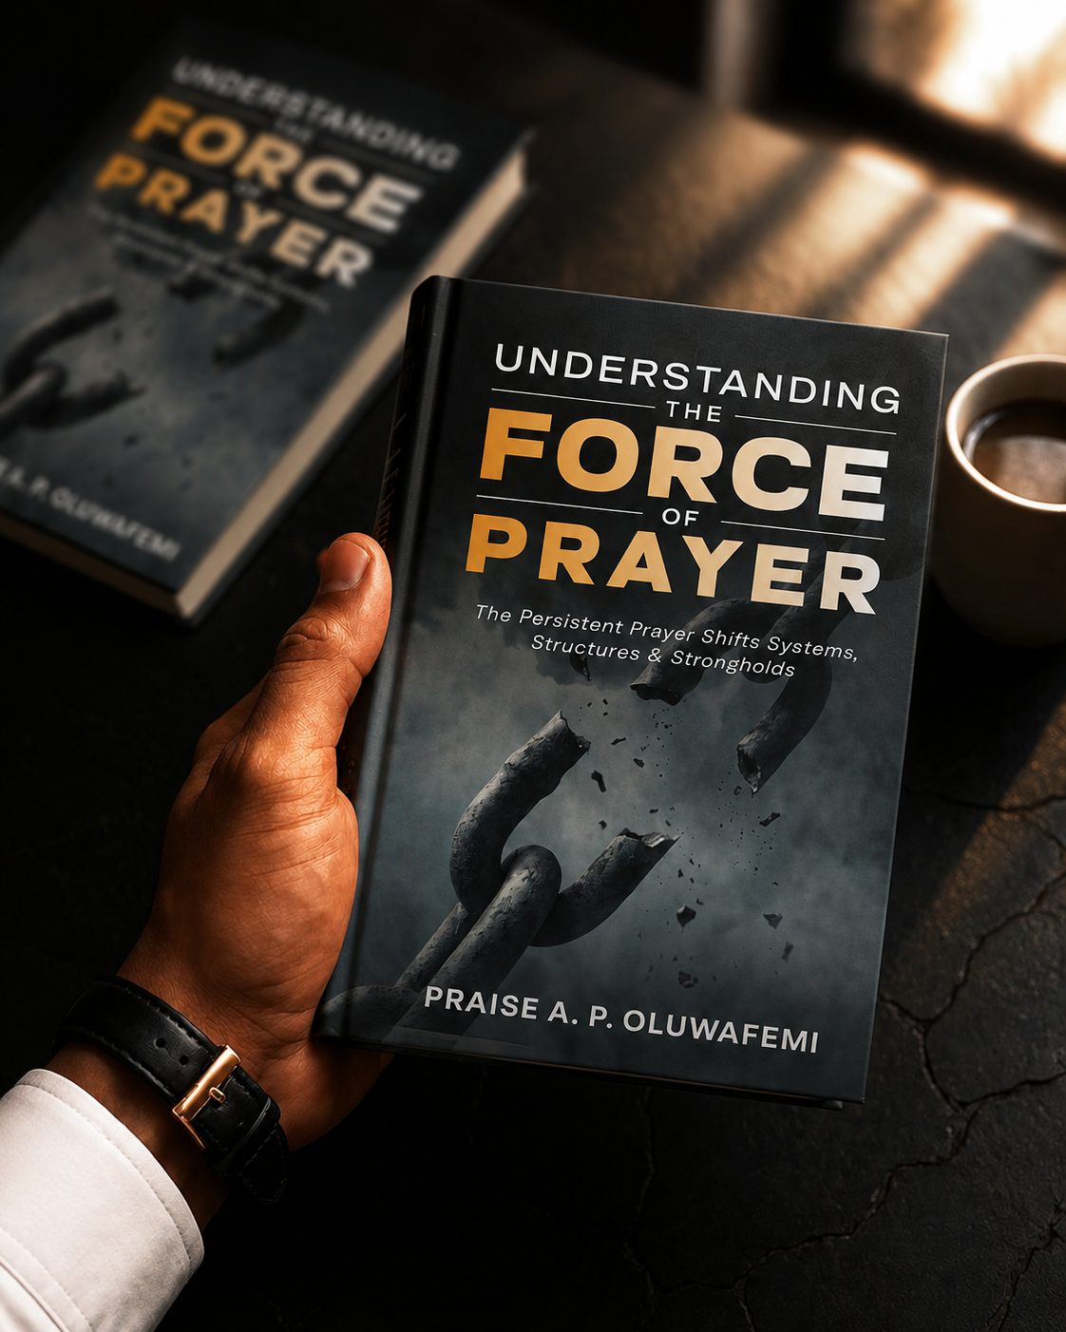
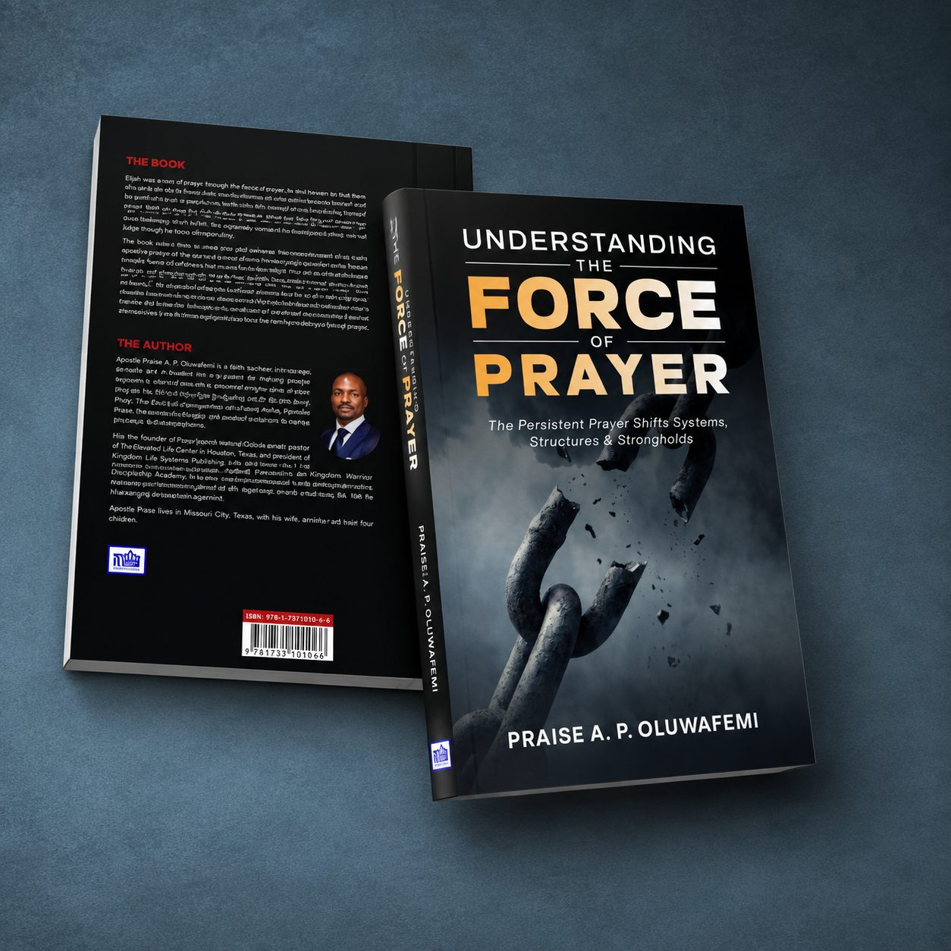
BOOK 02 · GALLERY 2/2
IN HAND · READER'S EDITION
FRONT & BACK SPREAD
9 / 30

Slide 10
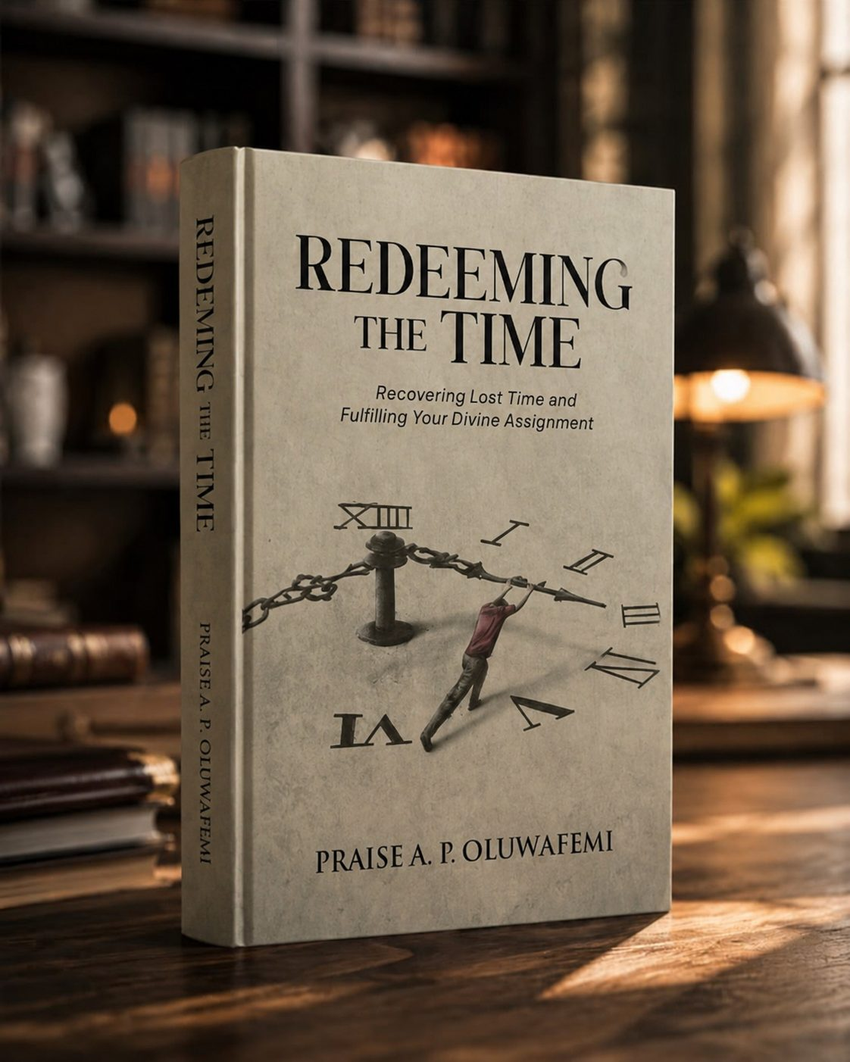
BOOK 03
03
Redeeming the Time
Recovering Lost Time and Fulfilling Your Divine Assignment
“Redeeming the time, because the days are evil.” — Ephesians 5:16
10 / 30

Slide 11
BOOK 03 · REDEEMING THE TIME
Inside this book, you will discover
Why your works carry the power to lose or recover your inheritance
How the blood of Jesus functions as legal currency in the courts of heaven
How the word of His grace turns promises into possessions
Taking an honest time inventory of your losses
How to plead the blood and advocate for your own restoration in the realm of the spirit
Standing on the Word instead of waiting for a turn that never comes
11 / 30

Slide 12
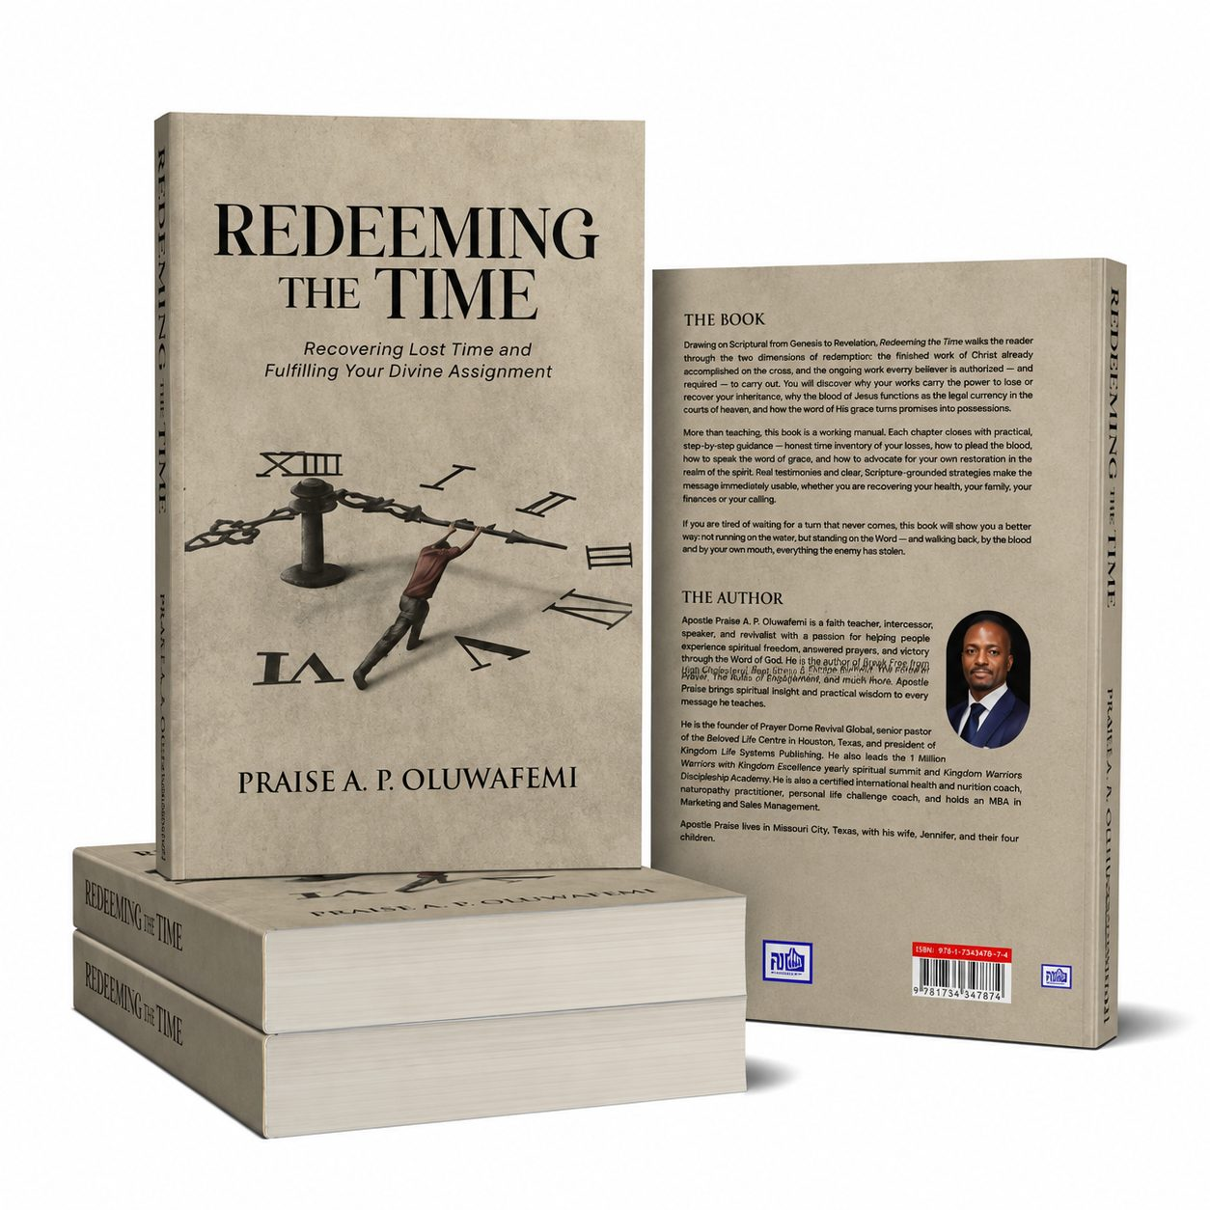
BOOK 03 · REDEEMING THE TIME · GALLERY 1/2
Drawing on Scripture from Genesis to Revelation, Redeeming the Time walks the reader through the two dimensions of redemption: the finished work of Christ already accomplished on the cross, and the ongoing work every believer is authorized — and required — to carry out. More than teaching, this book is a working manual. Each chapter closes with practical, step-by-step guidance, and real testimonies with clear, Scripture-grounded strategies make the message immediately usable, whether you are recovering your health, your family, your finances or your calling.
HARDCOVER · STUDY PRESENTATION
FRONT & BACK COVER
12 / 30

Slide 13
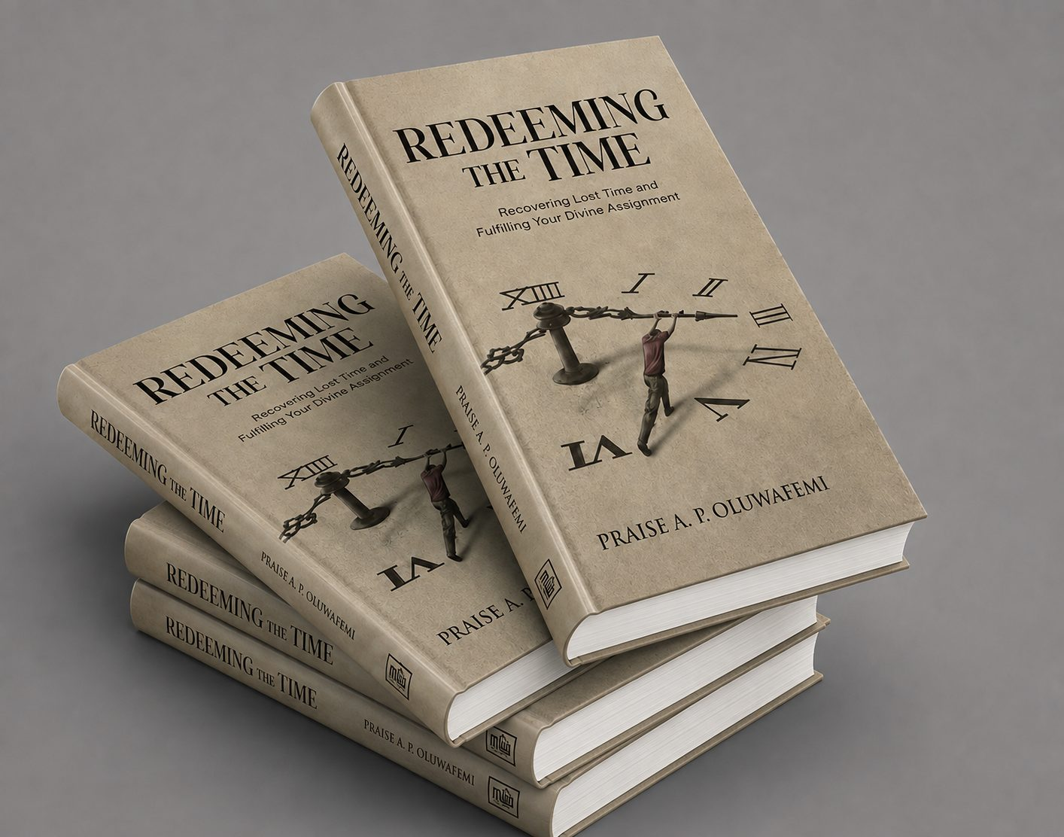
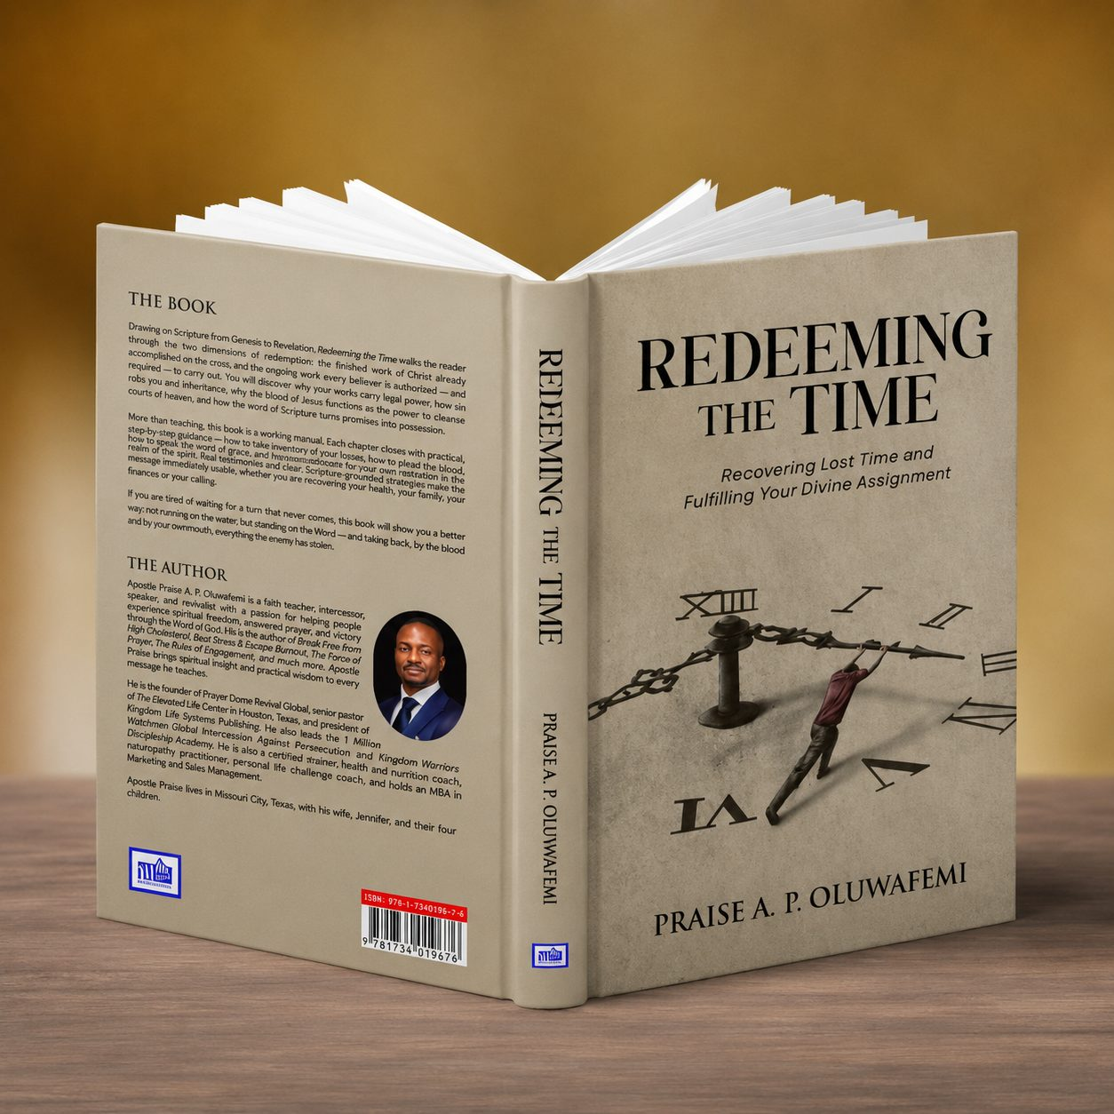
BOOK 03 · REDEEMING THE TIME · GALLERY 2/2
STACKED SET
OPEN SPREAD · AUTHOR PAGE
13 / 30

Slide 14
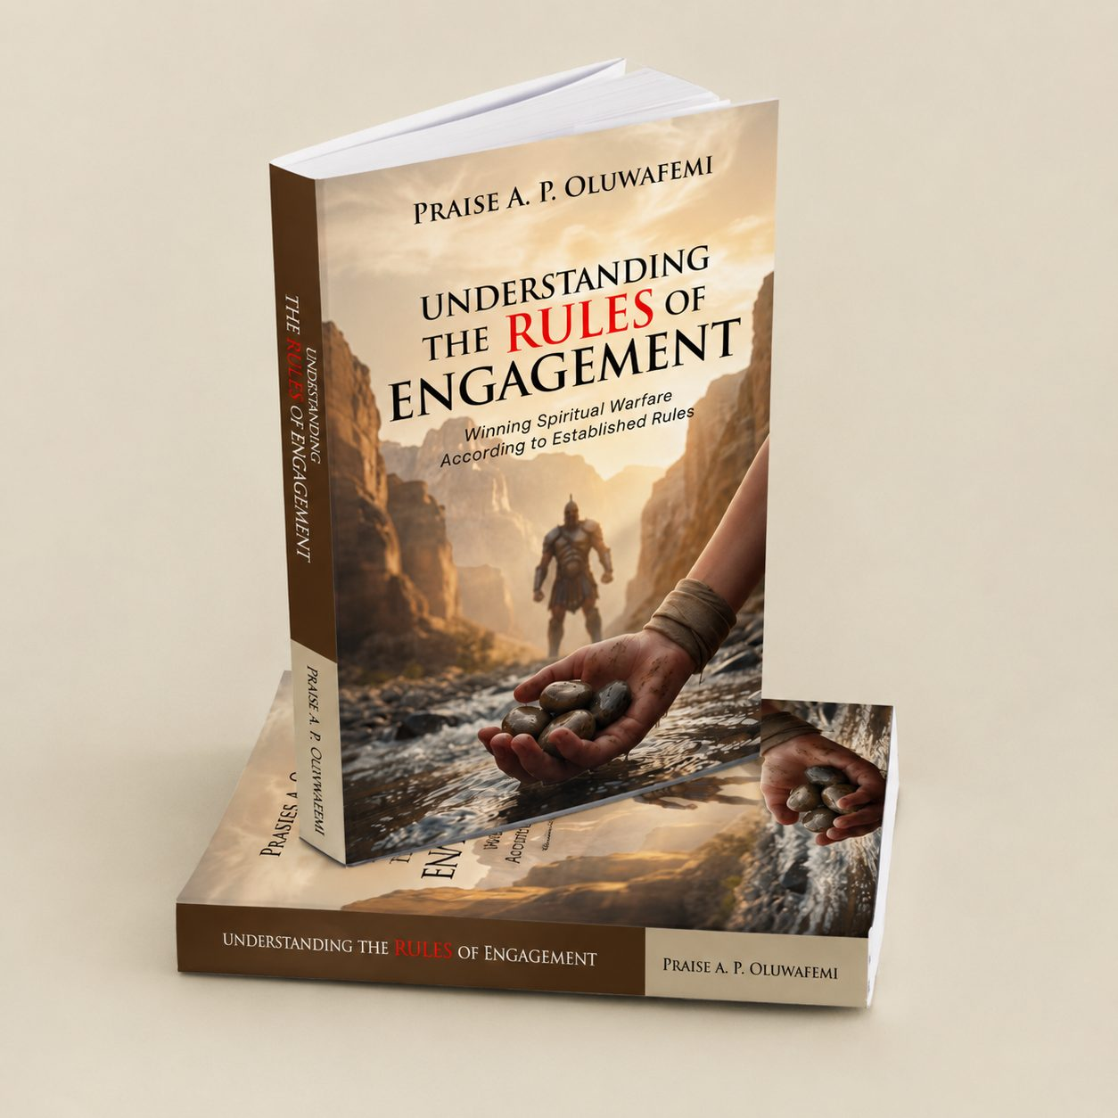
BOOK 04
04
Understanding the Rules of Engagement
Winning Spiritual Warfare According to Established Rules
“For though we walk in the flesh, we do not war after the flesh.” — 2 Corinthians 10:3
14 / 30

Slide 15
BOOK 04 · UNDERSTANDING THE RULES OF ENGAGEMENT
Inside this book, you will discover
Recognizing the battlefield you are already standing on
The fight that keeps circling the same argument, the same stall, the same 2 a.m. thought
Why none of it is random — and none of it has to keep winning
Warfare training anchored entirely in Scripture
Lessons drawn from Gideon to Elijah, from Nehemiah to Paul
The rules by which real spiritual battles are won
15 / 30

Slide 16
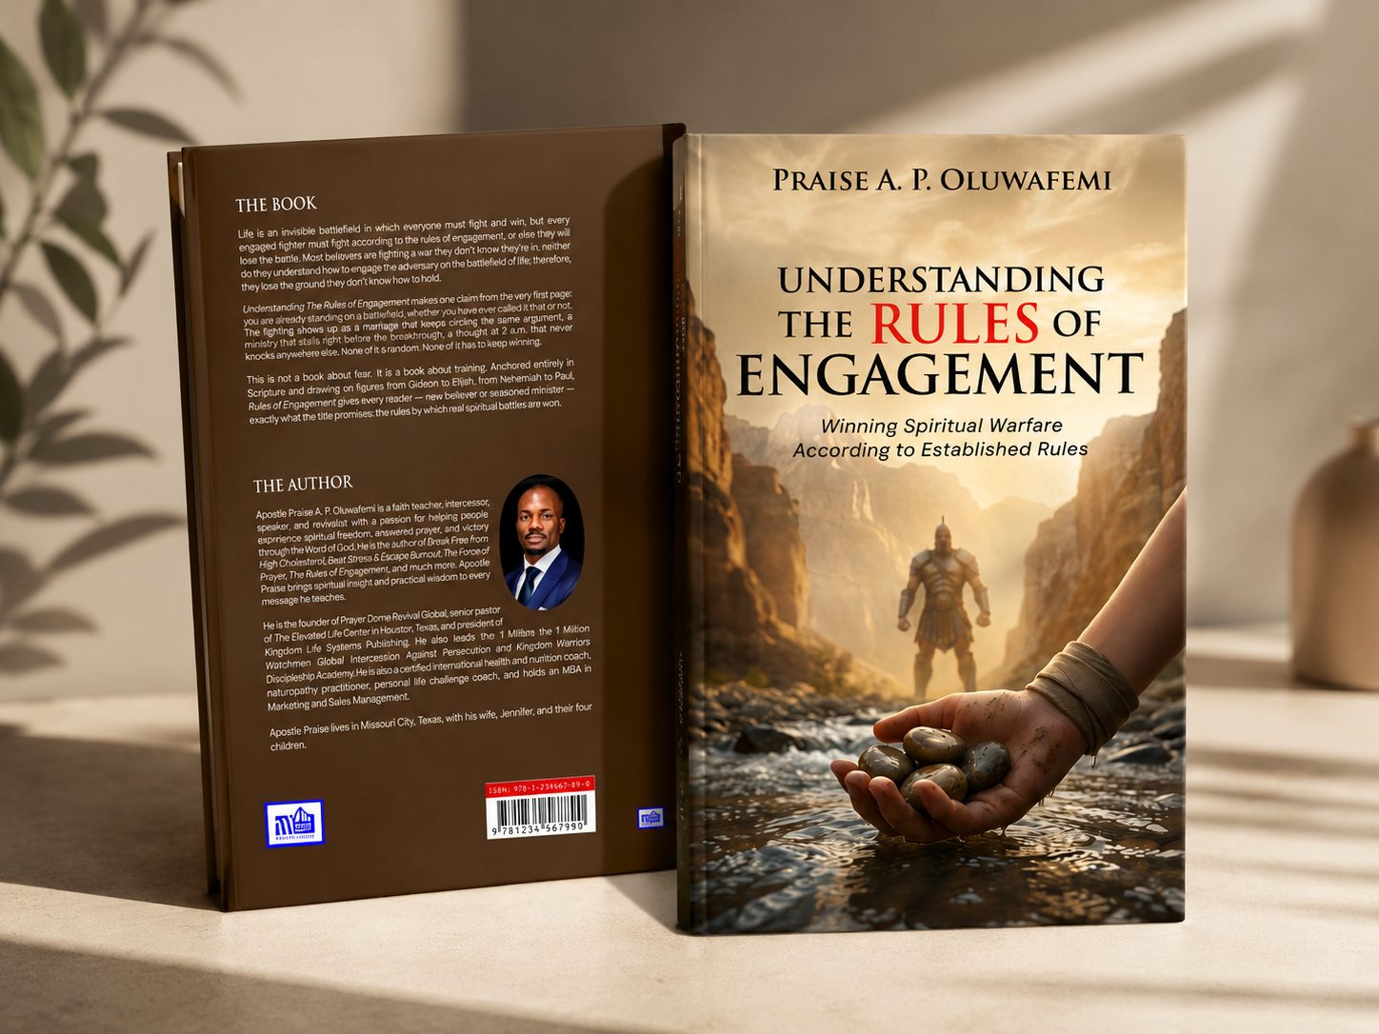
BOOK 04 · GALLERY 1/2
Life is an invisible battlefield in which everyone must fight and win, but every engaged fighter must fight according to the rules of engagement, or else they will lose the battle. Most believers are fighting a war they don't know they're in, neither do they understand how to engage the adversary on the battlefield of life — therefore they lose the ground they don't know how to hold. This book makes one claim from the very first page: you are already standing on a battlefield, whether you have ever called it that or not. This is not a book about fear. It is a book about training.
UPRIGHT · PAPERBACK PRESENTATION
FRONT & BACK COVER
16 / 30

Slide 17

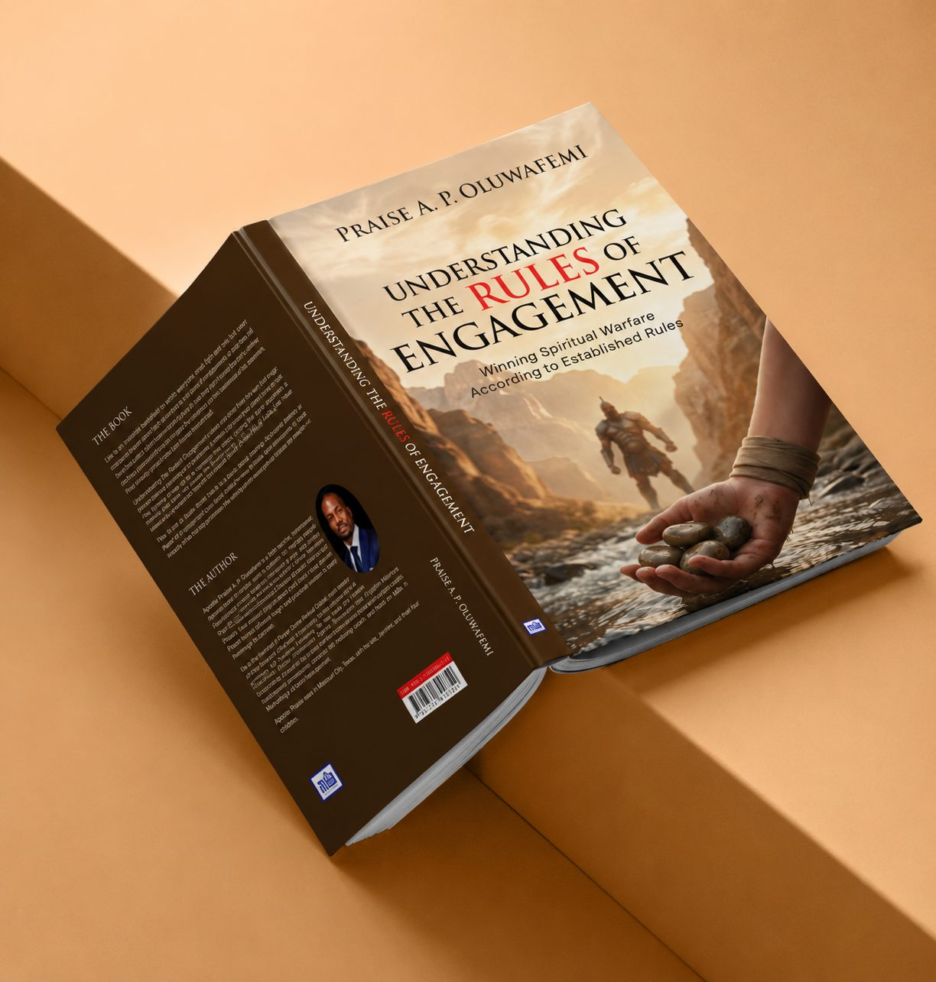
BOOK 04 · GALLERY 2/2
STACKED SET
FULL SPREAD · AUTHOR PAGE
17 / 30

Slide 18
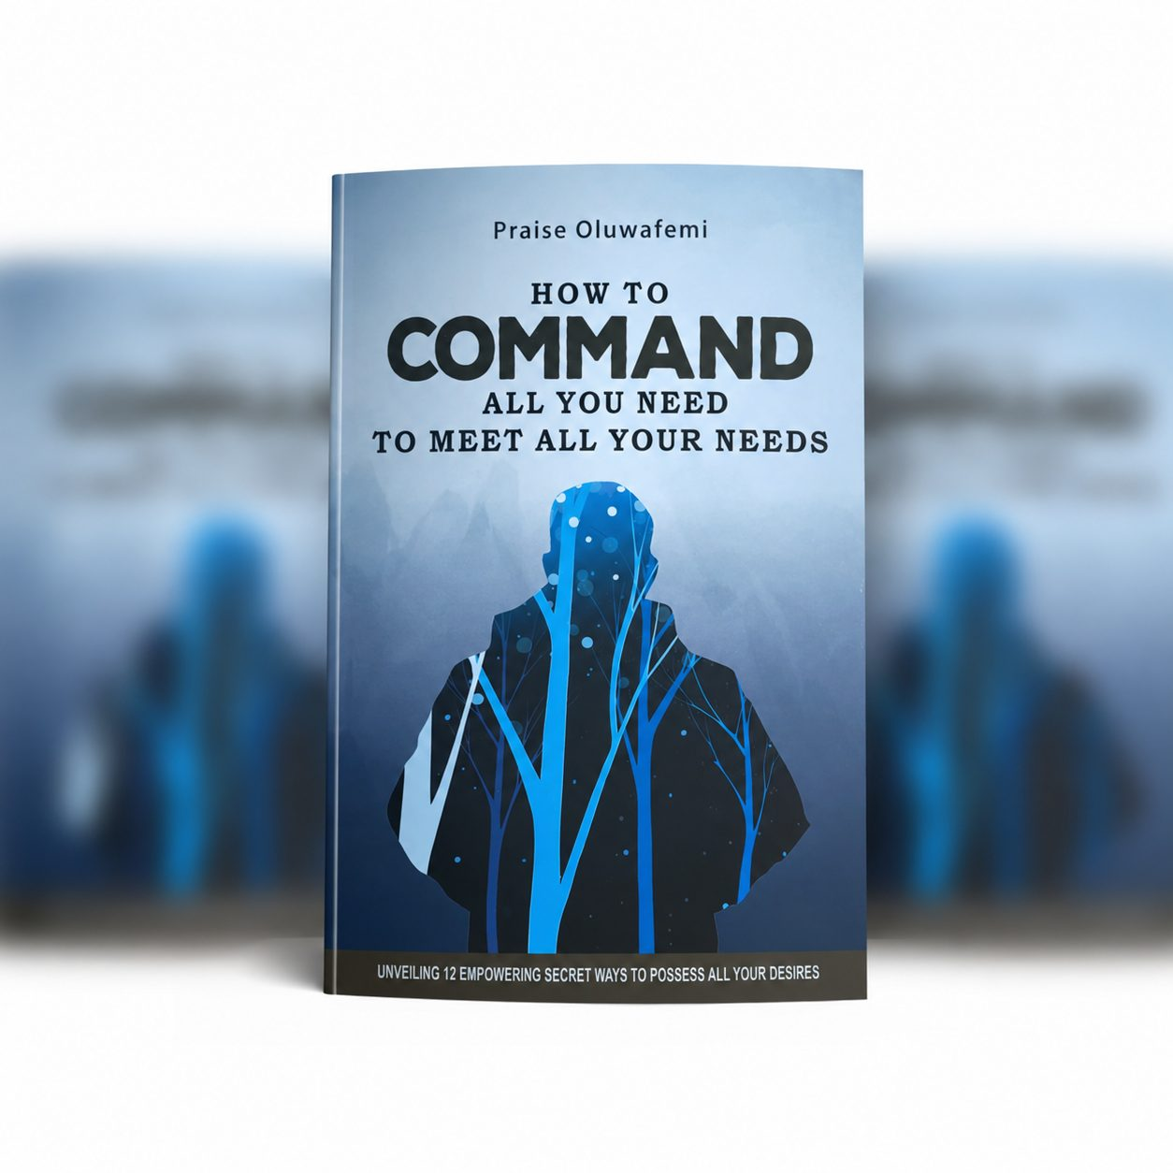
BOOK 05
05
How to Command All You Need to Meet All Your Needs
Unveiling 12 Empowering Secret Ways to Possess All Your Desires
“Thou shalt also decree a thing, and it shall be established unto thee.” — Job 22:28
18 / 30

Slide 19
BOOK 05 · HOW TO COMMAND ALL YOU NEED TO MEET ALL YOUR NEEDS
Inside this book, you will discover
12 empowering secret ways to possess all your desires
How to command provision instead of waiting on circumstances
Breaking out of limitation, stagnation and frustration
A testimony of supernatural healing that birthed the message
Simple steps — that demand your commitment
Why your breakthrough lies inches away from your deepest discouragement
19 / 30

Slide 20
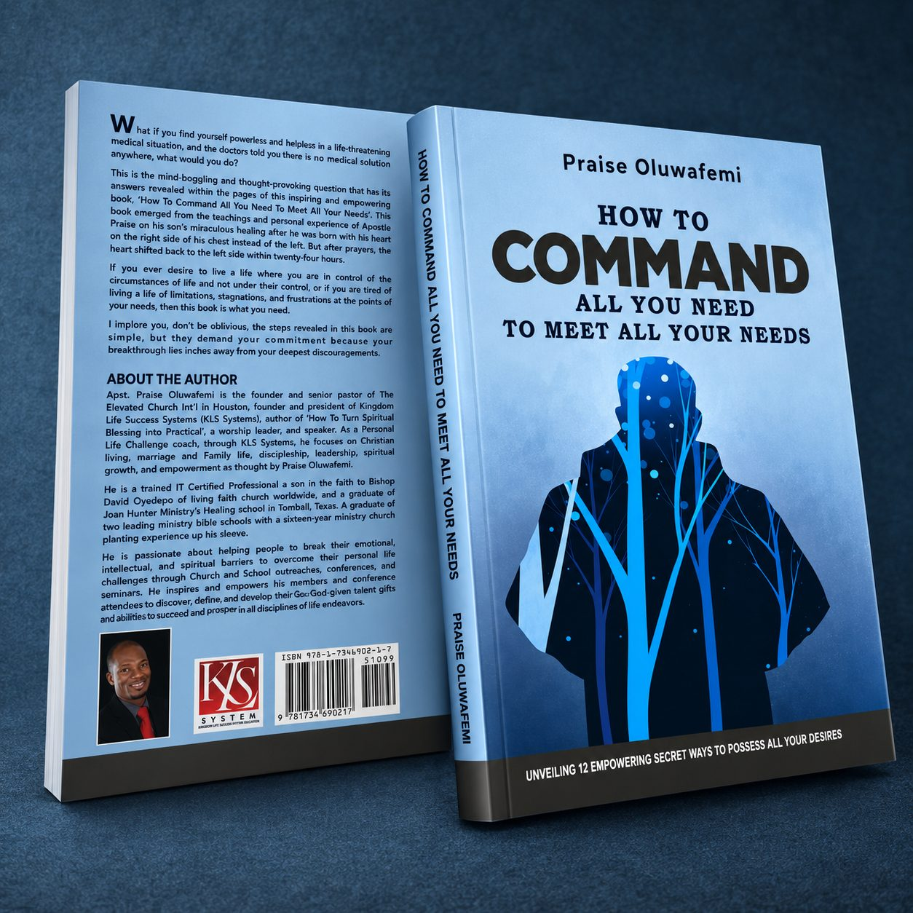
BOOK 05 · GALLERY 1/2
What if the doctors told you there was no medical solution anywhere — what would you do? That mind-boggling question is answered in this book, birthed from the teachings and personal experience of Apostle Praise following his son's miraculous healing: born with his heart on the right side of his chest, it shifted back to the left within twenty-four hours after prayer. Discover how to live in control of the circumstances of life rather than under their control.
FRONT COVER · PAPERBACK
FRONT & BACK COVER
20 / 30

Slide 21
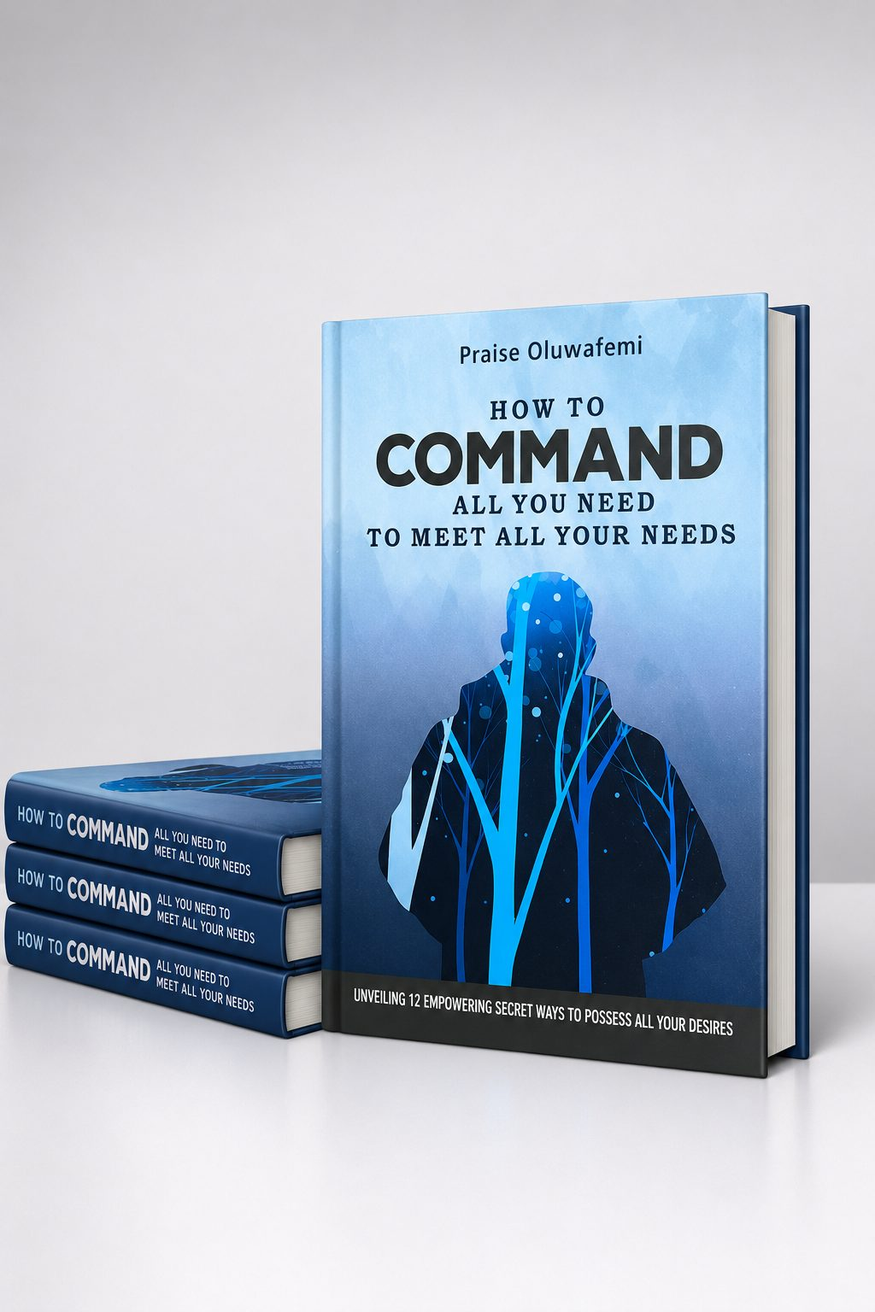
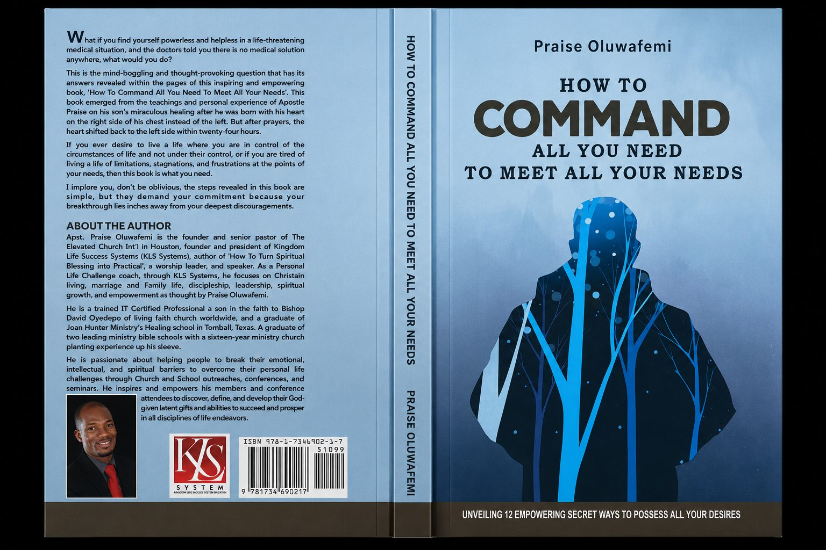
BOOK 05 · GALLERY 2/2
HARDCOVER · STACKED SET
FULL JACKET SPREAD
21 / 30

Slide 22

BOOK 06
06
Beat Stress and Escape Burnout
The High Achiever's Nutrition Guide to Sustainable Energy & Increase Productivity by 40%
“Beloved, I wish above all things that thou mayest prosper and be in health.” — 3 John 1:2
22 / 30

Slide 23
BOOK 06 · BEAT STRESS AND ESCAPE BURNOUT
Inside this book, you will discover
Understand your body for resilience — how stress impacts body and mind
Fuel your body: macronutrients, micronutrients, adaptogens and strategic supplementation
Cultivate mindful eating habits and anti-inflammatory nutrition
Master mindfulness and reimagine productivity: cell health, stress and healthy boundaries
Renew your fountain of youth — mitochondria and stem cell strategies for long-term wellbeing
Integrate faith for inner strength: spiritual nutrition and resistance to stress's effects
23 / 30

Slide 24
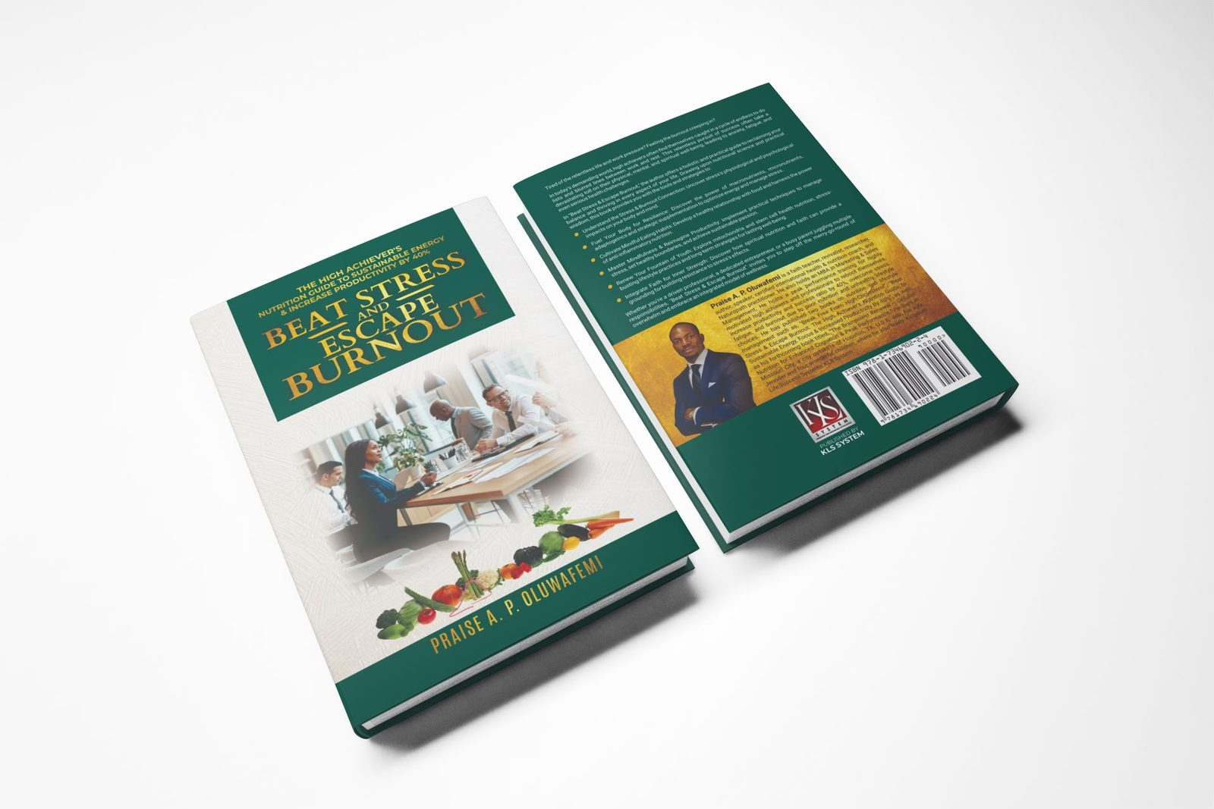
BOOK 06 · GALLERY 1/2
Tired of the relentless life and work pressure? Feeling the burnout creeping in? In today's demanding world, high achievers often find themselves caught in a cycle of endless to-do lists and blurred lines between work and rest. This relentless pursuit of success can take a devastating toll on physical, mental and spiritual well-being. Beat Stress & Escape Burnout offers a holistic and practical guide to reclaiming balance and thriving in every aspect of life — drawing upon nutritional science and psychological wisdom to optimize energy and manage stress.
PAPERBACK · STACKED SET
FRONT & BACK COVER
24 / 30

Slide 25


BOOK 06 · GALLERY 2/2
UPRIGHT · SPINE DETAIL
FAN DISPLAY
25 / 30

Slide 26

BOOK 07
07
Break Free from High Cholesterol
Detox It & Reclaim Your Heart Health Vitality
“I will restore health unto thee, and I will heal thee of thy wounds.” — Jeremiah 30:17
26 / 30

Slide 27
BOOK 07 · BREAK FREE FROM HIGH CHOLESTEROL
Inside this book, you will discover
What cholesterol really is — and why the numbers alone don't tell the story
How plaque builds in the arteries and what reverses the process
Detox foods, fiber and fats that actively lower cholesterol
Lifestyle habits that restore circulation and heart function
Supplements and natural supports worth knowing about
Faith and discipline as the foundation of lasting heart health
27 / 30

Slide 28
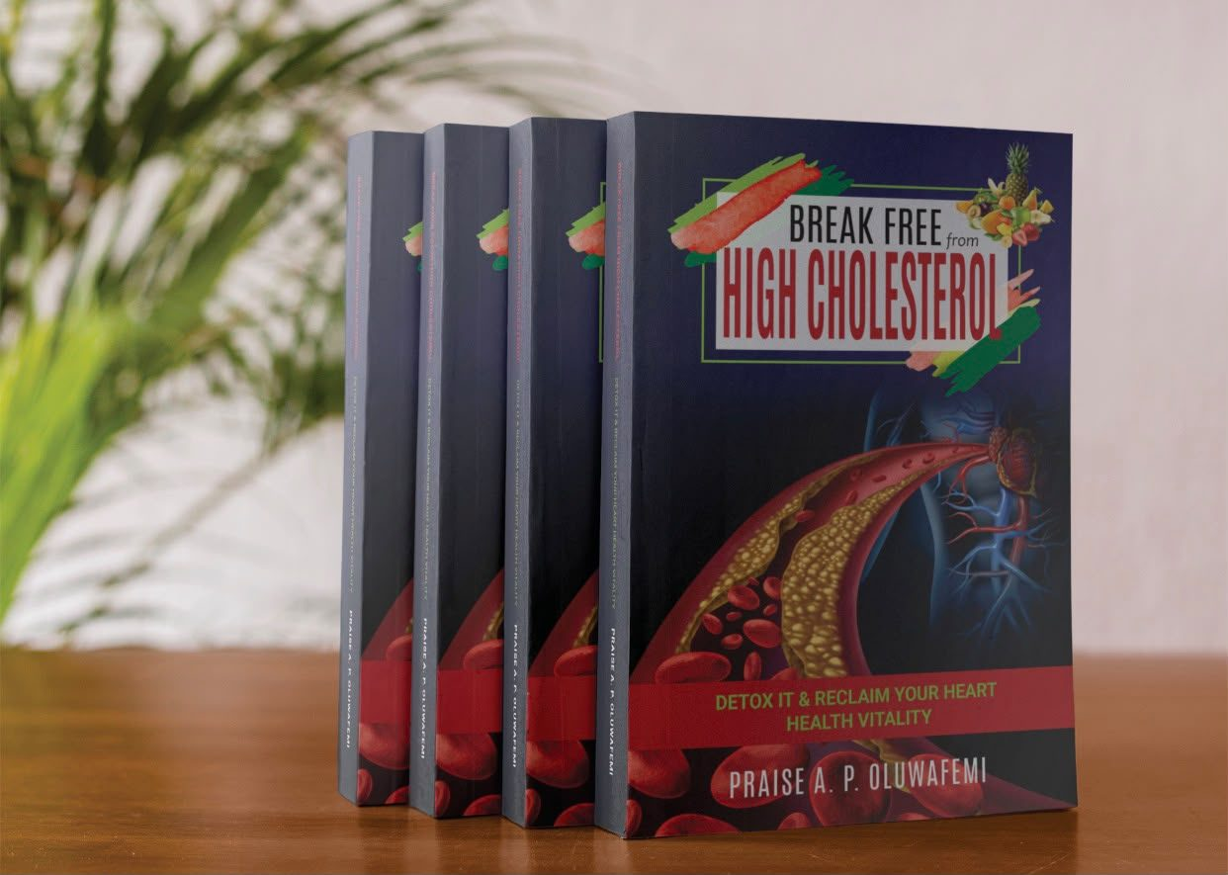
BOOK 07 · GALLERY 1/2
High cholesterol is a silent condition that quietly narrows the arteries and steals years of vitality before a single symptom appears. This book is a practical detox and restoration guide — combining nutrition, lifestyle strategy and faith to help readers clear what is clogging the arteries, rebuild heart health, and reclaim energy. Written with the same clarity as a coaching session, each chapter turns understanding into action.
FRONT COVER · PAPERBACK
STACKED SET · SPINE DETAIL
28 / 30

Slide 29
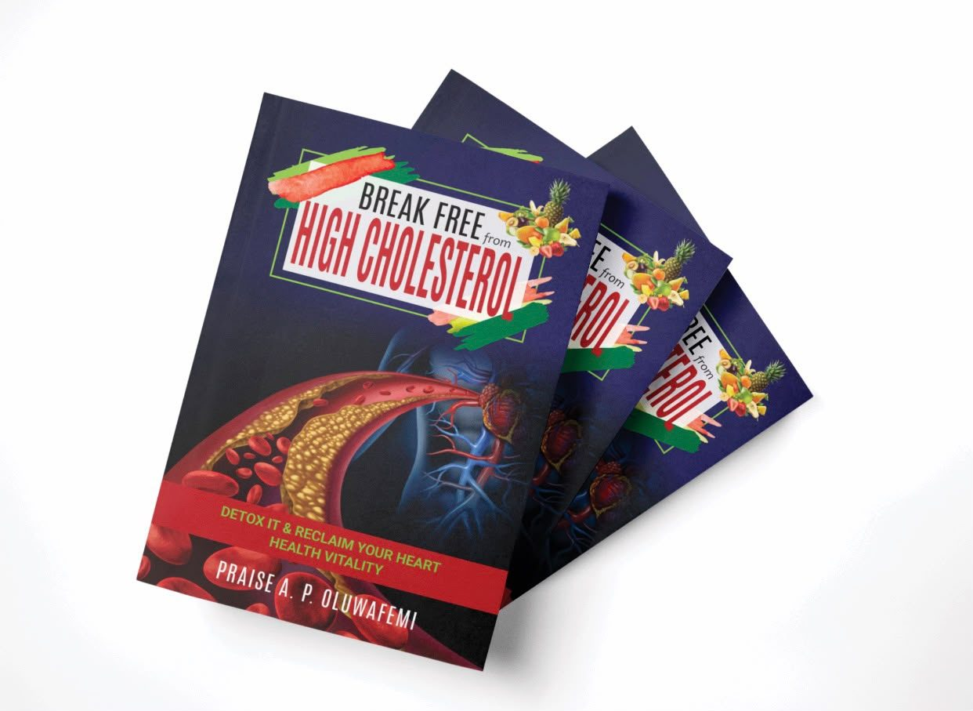
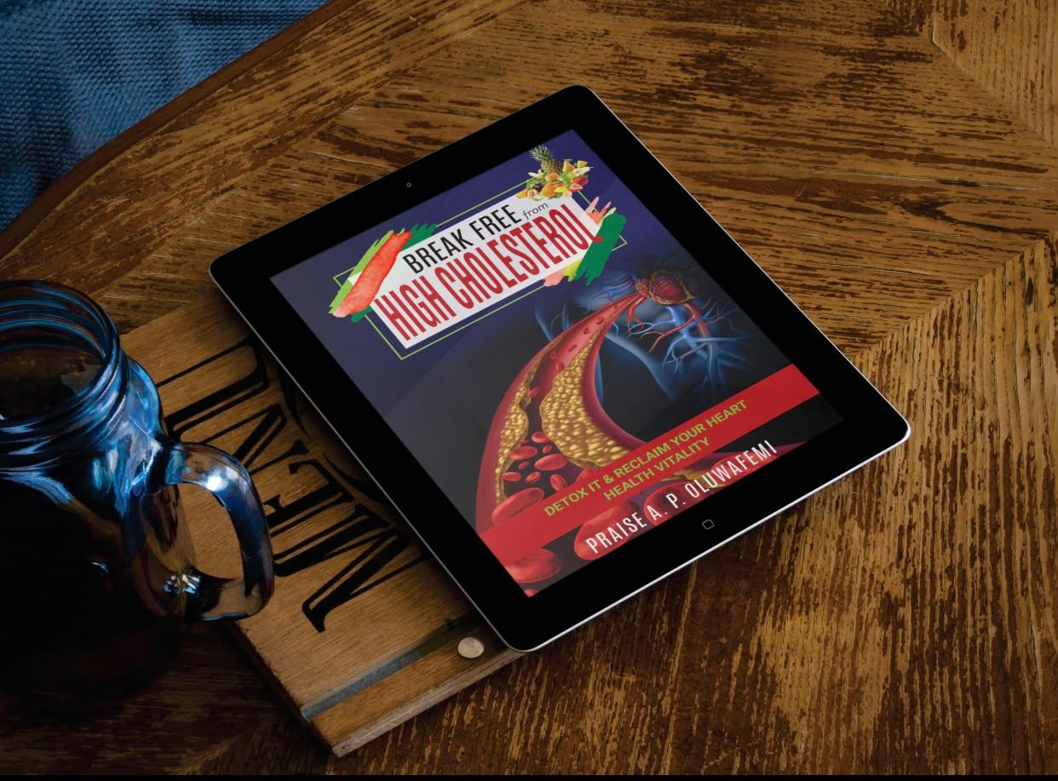
BOOK 07 · GALLERY 2/2
FAN DISPLAY
DIGITAL EDITION
29 / 30

Slide 30
KINGDOM LIFE SYSTEMS PUBLISHING
Seven books. One mandate.
Wealth multiplication · The force of prayer · Redeeming the time · The rules of engagement · Commanding all you need · Beating stress and burnout · Breaking free from high cholesterol.
Praise A. P. Oluwafemi
30 / 30

